Slide 1



Multi-Application Kiosk Mode
Using Intune and Windows 11 to Provide a Secured Desktop
wpninjas.ca

Slide 2

Agenda
+
Introduction
Overview - What is Kiosk Mode?
How do we create a Kiosk Mode profile in Intune?
Troubleshooting - Ok, it didn't work, now what?
How does it work in the background?

Slide 3






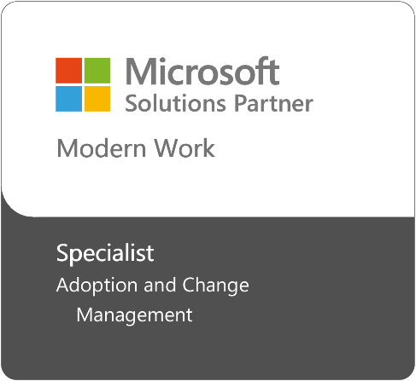






30 years of Microsoft Enterprise Technologies
integration and migration experience
Leading industry best practices to minimize business and operational disruptions
The most senior, tenured Microsoft Technology + Business Impact Consultants in Canada
Strong on-premises, hybrid and cloud experience
Inaugural 100 Microsoft FastTrack Ready Partner
Microsoft Adoption and Change Management Advanced Competency
1st Canadian Microsoft Cloud Partner
Azure Circle Partner and Microsoft Impact Award for Online Solutions
Trusted Western Canadian Infrastructure Partner

Slide 4

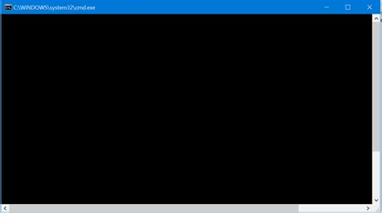
Introduction
+
C:\>Whoami
Matthew Armitage
Microsoft Cloud Solutions Architect
Steeves and Associates
Matthew.Armitage@steeves.net
Notes:
​Microsoft Cloud Solutions Architect​
Focus on Cloud Identity, Endpoint Management, Microsoft Security​
15 Years in K-12 IT at School District 72, Formerly Network and Security Analyst​
​
I also love talking about Smart Homes, Locksports, and most recently Meshtastic Radios​

Slide 5
What is Kiosk Mode?
+
Shell V1 and V2
Replaces System Shell
Only Available for Windows Enterprise and Education
Assigned Access
Available on Windows Pro, Enterprise and Education
Single App
Multi App
Stripped down user interface, scoped application access
No Desktop and Taskbar
No Desktop and Taskbar
Notes:
Single App
Digital Signage, Single use Appliances
Multi App
Stripped down user interface, scoped application access, used for limited use scenarios

Slide 6
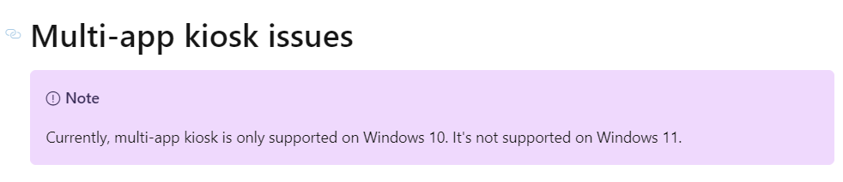
Multi-App Kiosk Mode
+
From: <Kiosk mode issues troubleshooting - Windows Client | Microsoft Learn>
Notes:
Guess What? Microsoft has sort of washed their hands of this…
Despite this, it still works, and it’s supposed to work.

Slide 7
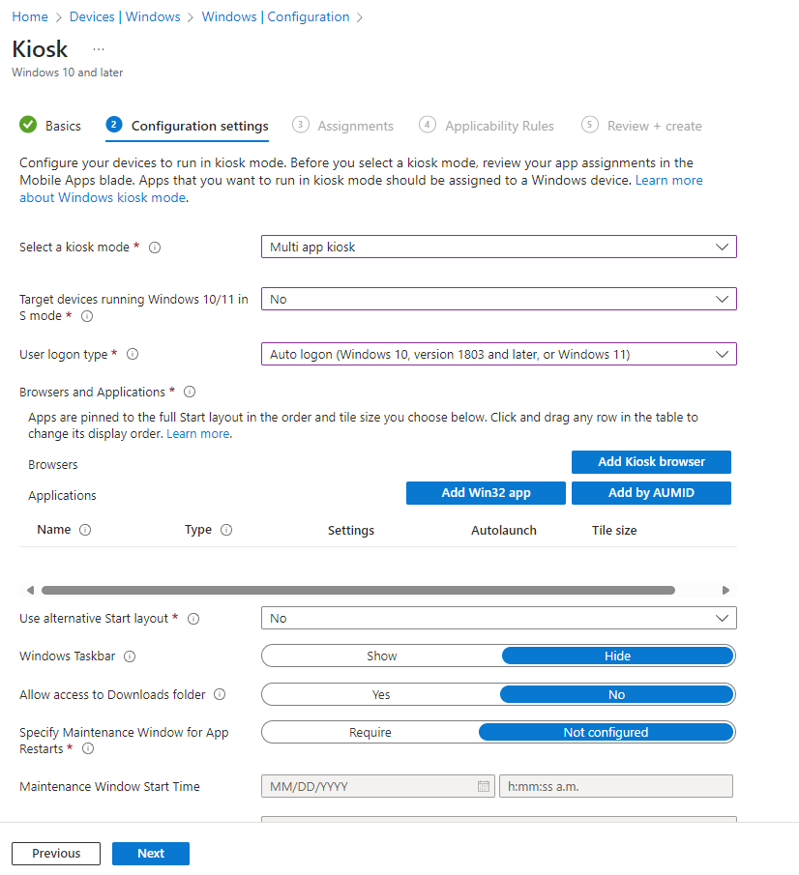



How do we make this work?
+
Notes:
Config Policy Template?
Totally broken in Win 11 - Avoid entirely
Only uses Assigned Access Definitions from 2018 (1809)

Slide 8
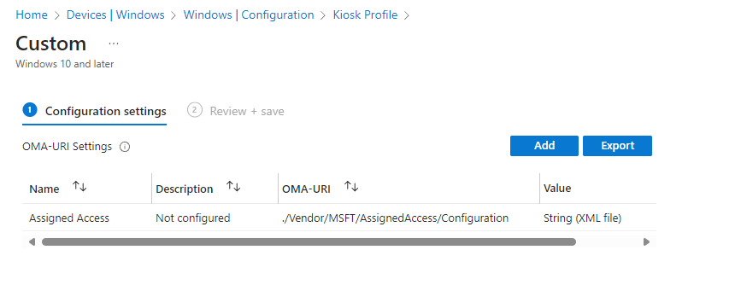

How do we make this work?
+
Notes:
Uses the Assigned Access CSP
https://learn.microsoft.com/en-us/windows/client-management/mdm/assignedaccess-csp
./Vendor/MSFT/AssignedAccess/Configuration

Slide 9
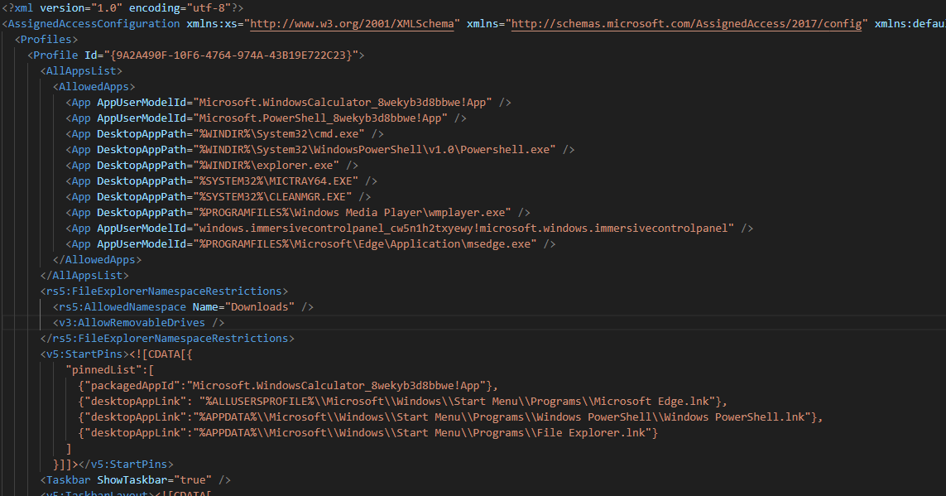
What do we need to do to deploy this?
+
Notes:
Needs a Properly formatted XML File
https://learn.microsoft.com/en-us/windows/configuration/assigned-access/examples?pivots=windows-11#restricted-user-experience

Slide 10
What do we need to do to deploy this?
+
XML Issues
Need to specify Apps by path, even though Applocker doesn't have to work that way…
No Wildcards, but can use system environmental variables
Windows Version Matters!
22h2 – Sort of works
23h2 – Working
24h2 – Working
Pay Attention to namespace tags for settings:
rs5:AllowedNamespace
v3:AllowRemovableDrives
v5:StartPins
Fully Broken
Any FileExplorerNamespaceRestriction settings (Haven't worked since the changes to Explorer in Win 11)
Notes:
Allowed Variables for Applocker (Doesn’t apply to Assigned Access XML):
Windows directory or drive AppLocker path variable Windows environment variable
Windows %WINDIR% %SystemRoot%
System32 and sysWOW64 %SYSTEM32% %SystemDirectory%
Windows installation directory %OSDRIVE% %SystemDrive%
Program Files %PROGRAMFILES% %ProgramFiles% and %ProgramFiles(x86)%
Removable media (for example, CD or DVD) %REMOVABLE%
Removable storage device (for example, USB flash drive) %HOT%

Slide 11

Defense In Depth
+
Notes:
Other Recommendations - Windows Update, Power Settings, Keyboard Filter, Lock screen notifications
https://learn.microsoft.com/en-us/windows/configuration/assigned-access/recommendations
Start Menu Lockdown
User Sign Out/Switch User

Slide 12
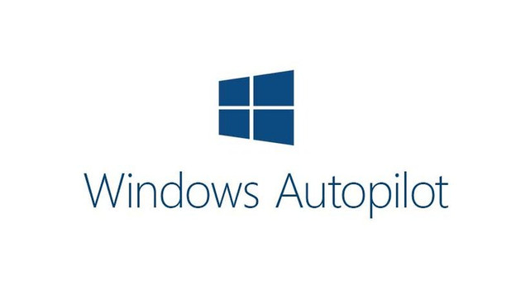

What about Autopilot?
Self Deploying Profile
Self Deploying Profile
Pairs great with Kiosk Mode for Quick Deployment
Autologon doesn’t configure correctly…
Intune Remediations to the Rescue!
Notes:
Use with Autopilot Self Deploying Profile, but watch out:
Autologon problems
Fix with Remediation Script

Slide 13
Troubleshooting
+
What to do when nothing seems to work
Event Viewer
Applications and Services Logs -> Microsoft -> Windows -> Assigned Access - Admin
Find errors in Assigned Access XML
Find errors applying profile
What to do when Apps don’t work
Event Viewer
Applications and Services Logs -> Microsoft -> Windows -> AppLocker
Look for 8004 Events
Where else to look
Event Viewer
Applications and Services Logs -> Microsoft -> Windows -> Assigned Access - Operational
Needs to be enabled
Can also point to XML errors, especially with app strings
Notes:
What is it?
Just in time role access
Elevate to roles when needed - No privileged access to steal!
Concept: Active vs Eligible
Active - User has role rights
Eligible - User can ask for role rights
How do we use it?
Elevation flow demo
How do we transition to it?
Demo moving standing admin to eligible admin
Include adding global reader.

Slide 14

Whoami Again?
Easy Quick Setup
Matthew Armitage
Microsoft Cloud Solutions Architect
Steeves and Associates
Matthew.Armitage@steeves.net

Slide 15
Examples
Easy Quick Setup
Assigned Access XML files:
https://github.com/matthew-armitage-steeves/wpninjaca/blob/main/Multi-Application%20Kiosk%20Mode%20with%20Intune%20and%20Windows%2011/assignedaccessprofile-multiapp.xml
https://github.com/matthew-armitage-steeves/wpninjaca/blob/main/Multi-Application%20Kiosk%20Mode%20with%20Intune%20and%20Windows%2011/assignedaccessprofile-singleapp.xml
AppLocker XML files:
https://github.com/matthew-armitage-steeves/wpninjaca/blob/main/Multi-Application%20Kiosk%20Mode%20with%20Intune%20and%20Windows%2011/applocker-example.xml
Broken Intune Configuration Template XML:
https://github.com/matthew-armitage-steeves/wpninjaca/blob/main/Multi-Application%20Kiosk%20Mode%20with%20Intune%20and%20Windows%2011/intune-config-template-ouput.xml
Assigned Access Generated AppLocker XML:
https://github.com/matthew-armitage-steeves/wpninjaca/blob/main/Multi-Application%20Kiosk%20Mode%20with%20Intune%20and%20Windows%2011/applocker-assigned-access-output.xml
Intune Remediation:
https://github.com/matthew-armitage-steeves/wpninjaca/blob/main/Multi-Application%20Kiosk%20Mode%20with%20Intune%20and%20Windows%2011/Fix-KioskMode.ps1
https://github.com/matthew-armitage-steeves/wpninjaca/blob/main/Multi-Application%20Kiosk%20Mode%20with%20Intune%20and%20Windows%2011/Detect-RegistrySettings.ps1
https://github.com/matthew-armitage-steeves/wpninjaca/blob/main/Multi-Application%20Kiosk%20Mode%20with%20Intune%20and%20Windows%2011/Remediate-RegistrySettings.ps1

Slide 16
Resources
Easy Quick Setup
Assigned Access Info
https://learn.microsoft.com/en-us/windows/configuration/assigned-access/configuration-file?pivots=windows-11
https://learn.microsoft.com/en-us/windows/configuration/assigned-access/examples?pivots=windows-11
https://learn.microsoft.com/en-us/windows/configuration/assigned-access/policy-settings
https://learn.microsoft.com/en-us/windows/configuration/assigned-access/xsd
https://learn.microsoft.com/en-us/windows/client-management/mdm/assignedaccess-csp
https://learn.microsoft.com/en-us/windows/client-management/mdm/policy-csp-kioskbrowser
https://learn.microsoft.com/en-us/troubleshoot/windows-client/shell-experience/kiosk-mode-issues-troubleshooting
https://learn.microsoft.com/en-us/windows/configuration/store/find-aumid?tabs=ps
AppLocker Info
https://call4cloud.nl/lingering-deleting-old-applocker-policy/
https://call4cloud.nl/applocker-event-log-troubleshooting-8004/
https://learn.microsoft.com/en-us/windows/security/application-security/application-control/app-control-for-business/applocker/understanding-the-path-rule-condition-in-applocker
https://hinchley.net/articles/an-approach-for-managing-microsoft-applocker-policies
https://lolbas-project.github.io/
https://learn.microsoft.com/en-us/windows/configuration/assigned-access/policy-settings
Shell Launcher
https://learn.microsoft.com/en-us/windows/configuration/assigned-access/shell-launcher/?tabs=intune
https://learn.microsoft.com/en-us/windows/iot/iot-enterprise/customize/shell-launcher
https://learn.microsoft.com/en-us/windows/configuration/assigned-access/shell-launcher/configuration-file
Lockdown
https://learn.microsoft.com/en-us/windows/iot/iot-enterprise/customize/keyboardfilter
https://learn.microsoft.com/en-us/windows/iot/iot-enterprise/customize/keyboardfilter-powershell-script-samples
Other Notes
https://sysmansquad.com/2021/07/02/setting-environmental-variables-with-intune-and-proactive-remediations/

